Slide 1

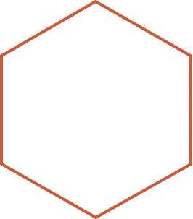

Pension Management System
Project By : Kakarala Lalitha Sri
Employee Id : 2174047

Slide 2
Agenda
Introduction
Functionality
Implemented Methods
Architecture of Application
Procedure

Slide 3
Dockerization
Steps of Dockerization
Requirements
Advantages
Conclusion

Slide 4

Introduction
Pension Management System is an user friendly application by which employer and employee can check the pension details. It contains many features such as create applicant, check status, check balance, check application, issue pension ,load pension. This project is build as per Java Microservices Architecture with the help of spring-boot.
4

Slide 5
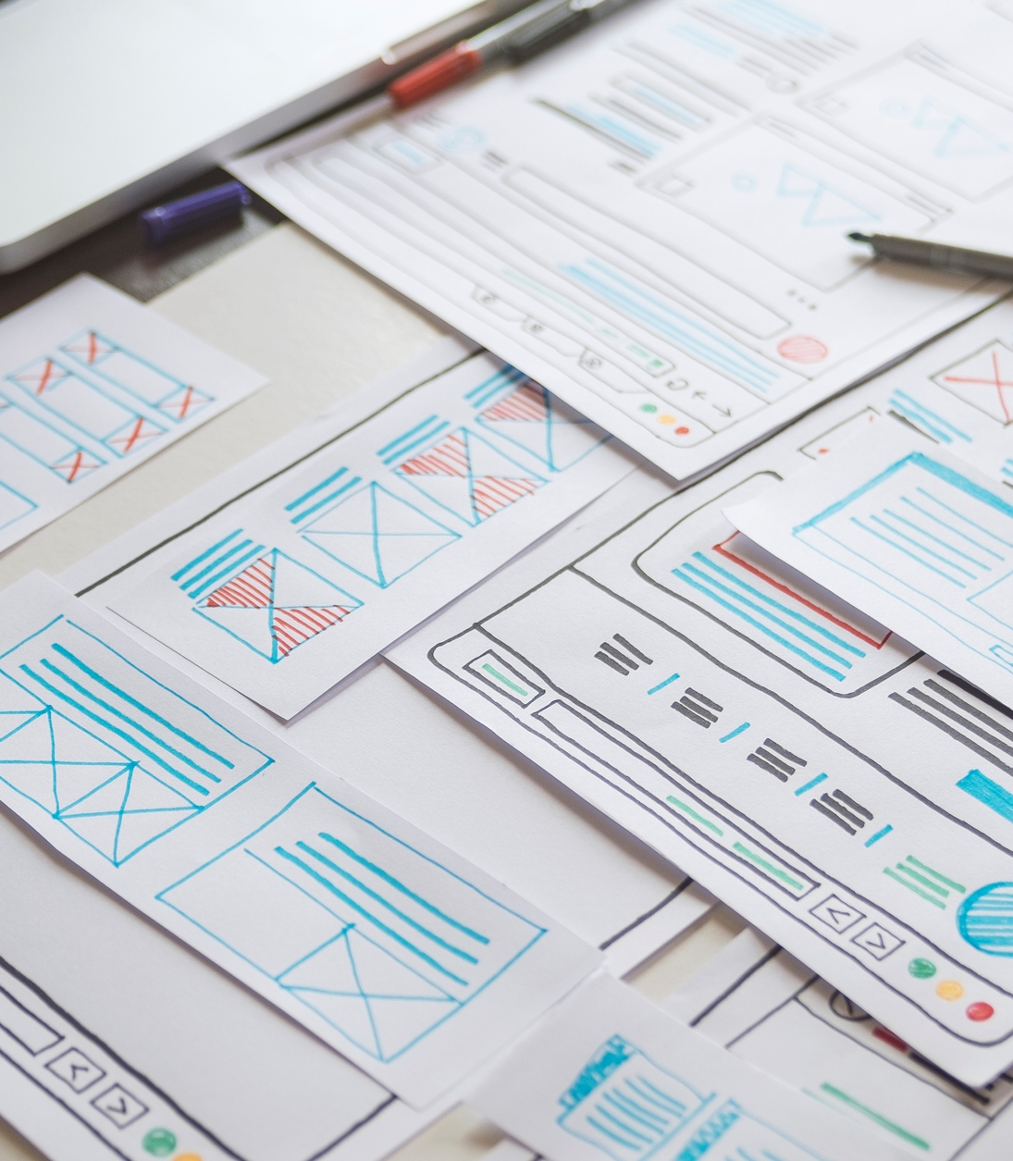
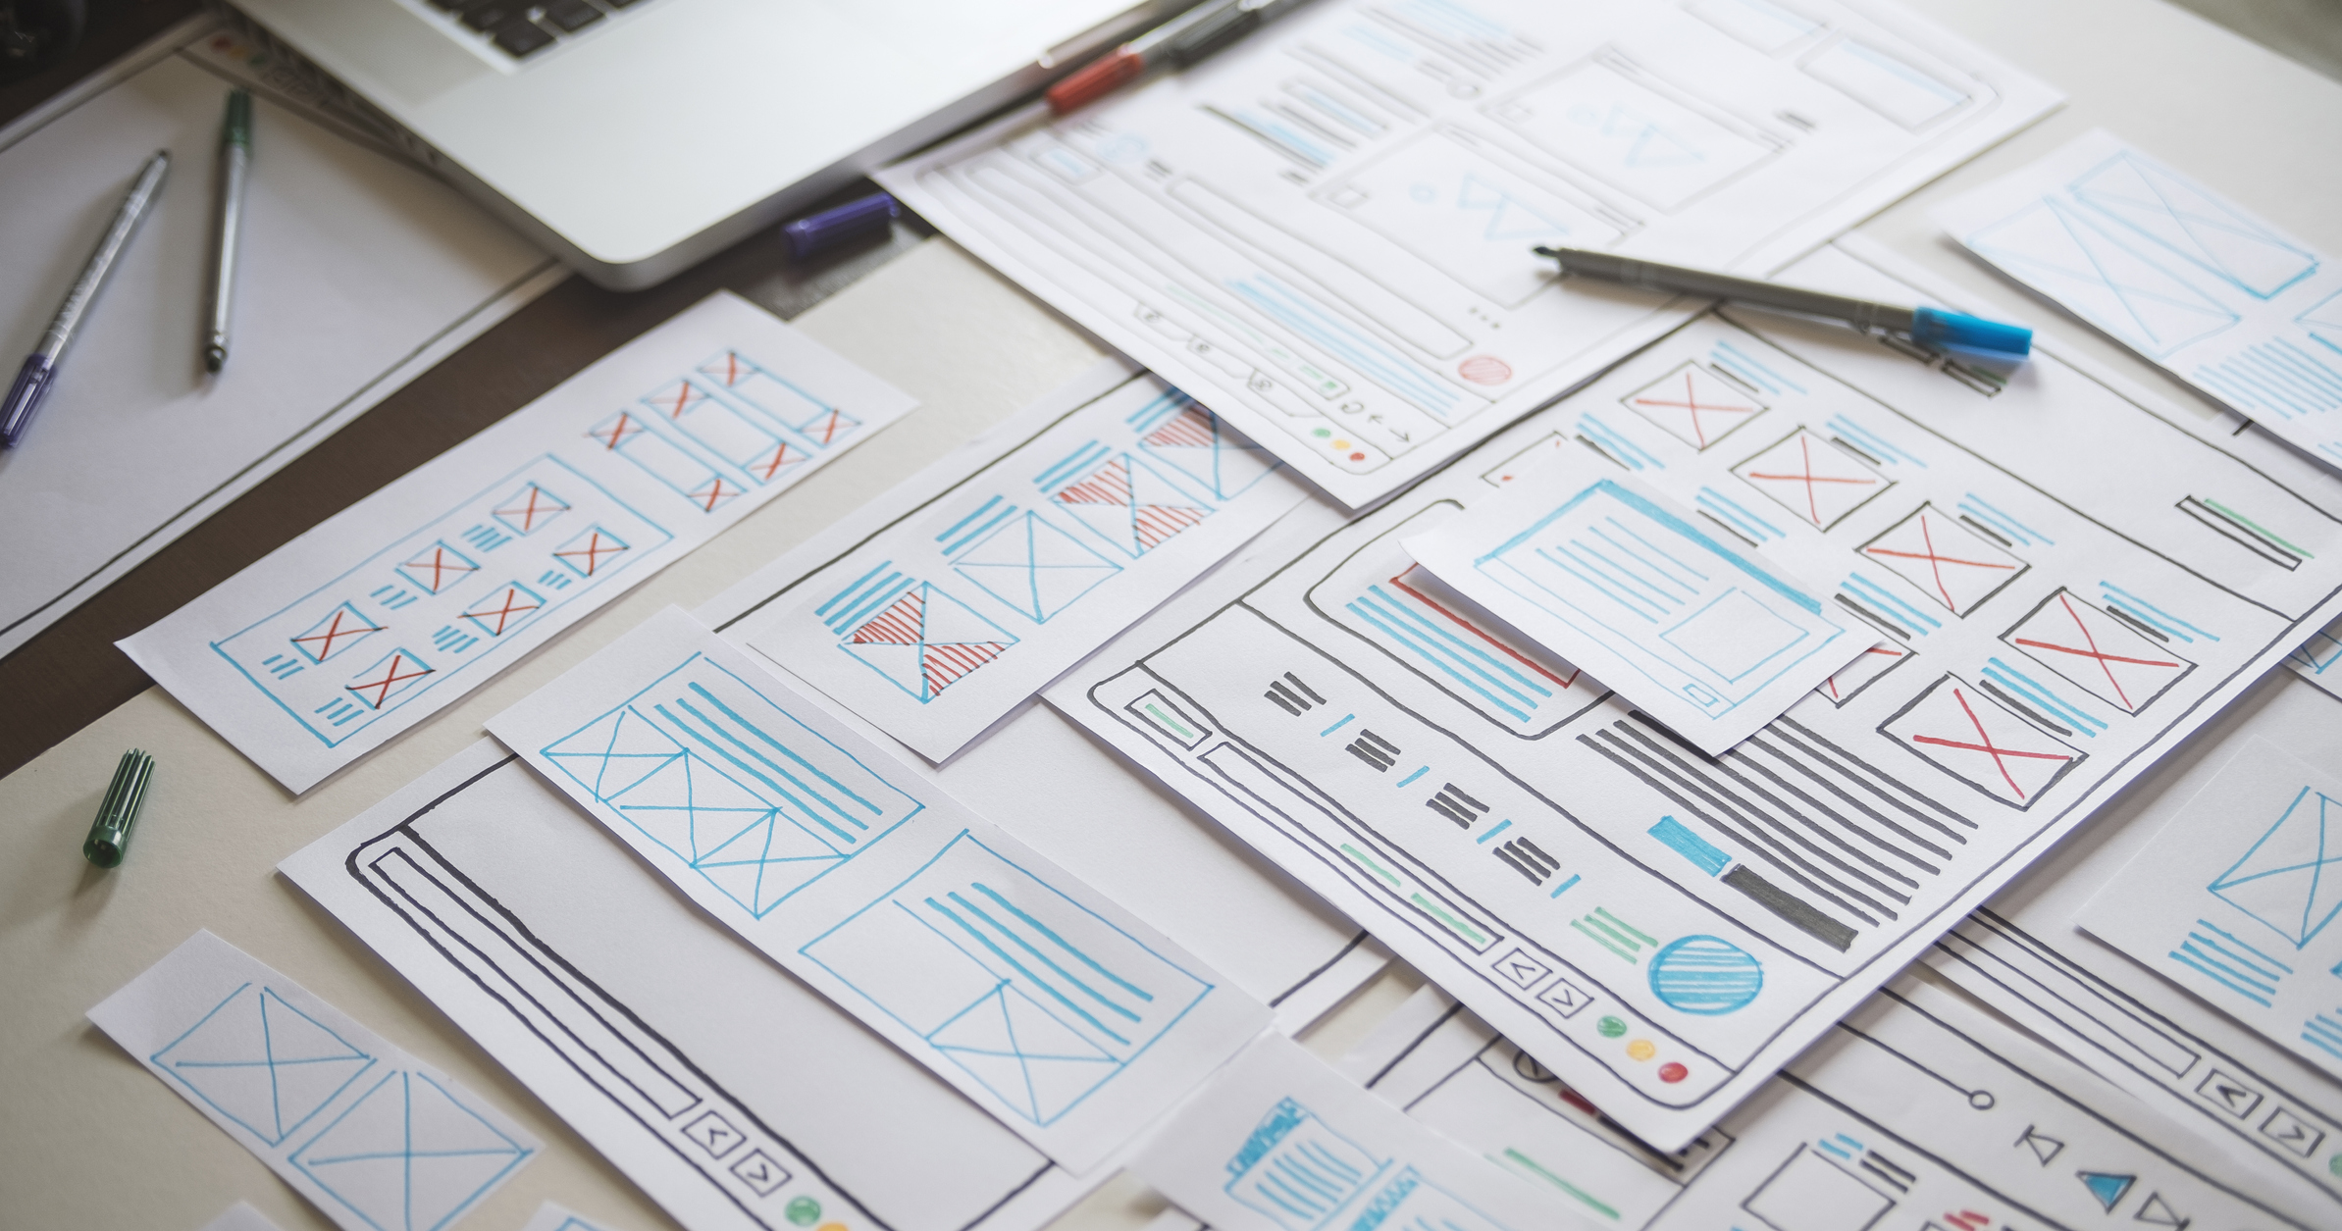
1.Add Pensioner/Employee Records 2. View Employee Records 3. Search Records(by id) 4. Calculate Pension(by their status)
Functionality

Slide 6
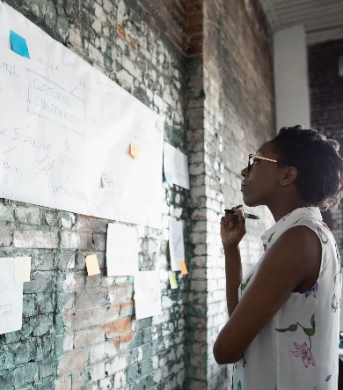



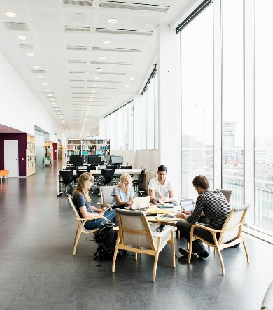
Implemented Methods
Issue Pension
Load Pension
Create Applicant
Check Status
Check Balance
Check Application
6

Slide 7
Project Architecture
Repository class extending CRUD services
client
controller
Service layer
model
database
7

Slide 8

Procedure
1.Project structure is created using Spring Initializr by adding all the required dependencies, plugins and versions.
2.Write required classes and methods. 3.We have to install all the dependancies by doing mvn clean install.
4.Start mysql image in docker using docker-compose -f dockercompose-mysql.yml up -d
5.We have to run the application by using maven spring-boot:run.
6.Tomcat Apachevserver will be started after running the project.
7.Work on the data in Postman by using url https://localhost: port number/method na
Niche Markets
ROI
hains
8

Slide 9

Dockerization
Docker is an open source platform that enables developers to build, deploy, run, update and manage containers.
Docker containers can run anywhere, However, Windows images can run only on Windows hosts and Linux images can run on Linux hosts
9

Slide 10
Steps of Dockerization
To dockerization we need Dockerfile in our application.
After that start docker from docker desktop
Run command mvn install dockerfile:build
Check docker desktop weather image is created or not
Push to docker hub from docker desktop

Slide 11
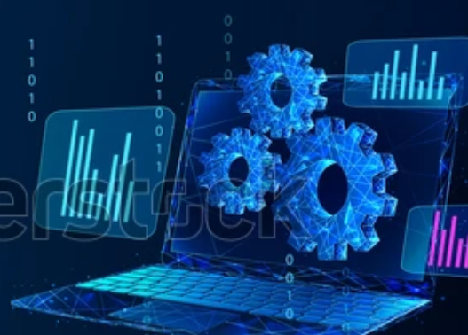
System Requirements
Software Requirements :
Java
Spring-boot
MySQL
Maven Docker IDE(IntelliJ/Eclipse)
Hardware Requirements :
Windows OS
Internet connection

Slide 12
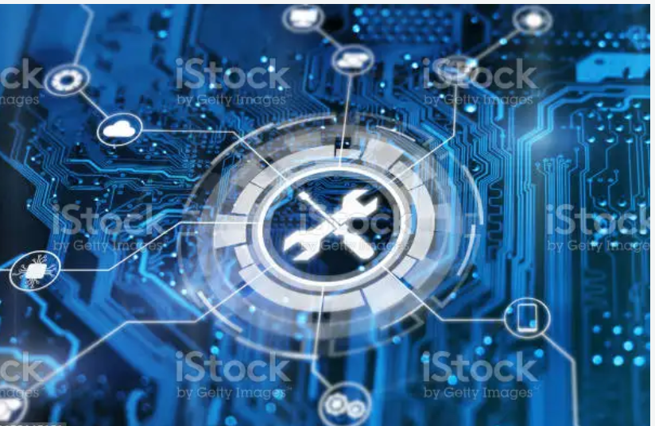
Advantages
It is an User friendly application.
database helps to minimize data redundancy.
User can easily perform operations like add, update, search, delete the data from database.

Slide 13
Conclusion
This Pension Management System is designed to manage pension activities for both applicants and pension admins. It is goot for organization as well as employee because it is easy to use. This project is all about the solution that will largely help eliminate the problems associated with the manual process and easy to manage pensions.

Slide 14


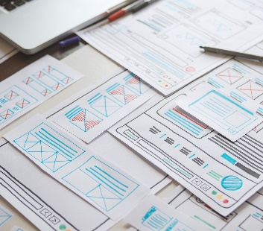
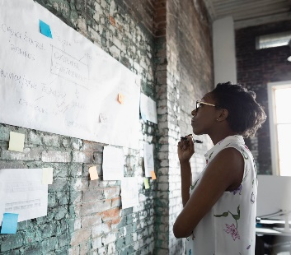
Thank you

